Slide 1
Pilot study: Detection of bacterial plasmids using NGS Bioinformatics analysis by M. Reczko, BSRC A. Fleming
The following samples were sequenced using the Ion Proton:
KLPNC1-ecoli-res (1453369 reads, Mean Read Length: 130 bp)
KLPNC2-Trs502 (1091825 reads, Mean Read Length: 131 bp)
KLPNC3-Trs8 (1434440 reads, Mean Read Length: 133 bp)
All reads were aligned to the provided reference assemblies:
WG5 - the recipient E.coli (4522677 bp)
Trs502 (100886 bp)
Trs8 (93387 bp)
using bwa (version 0.7.16a) with default parameters.

Slide 2
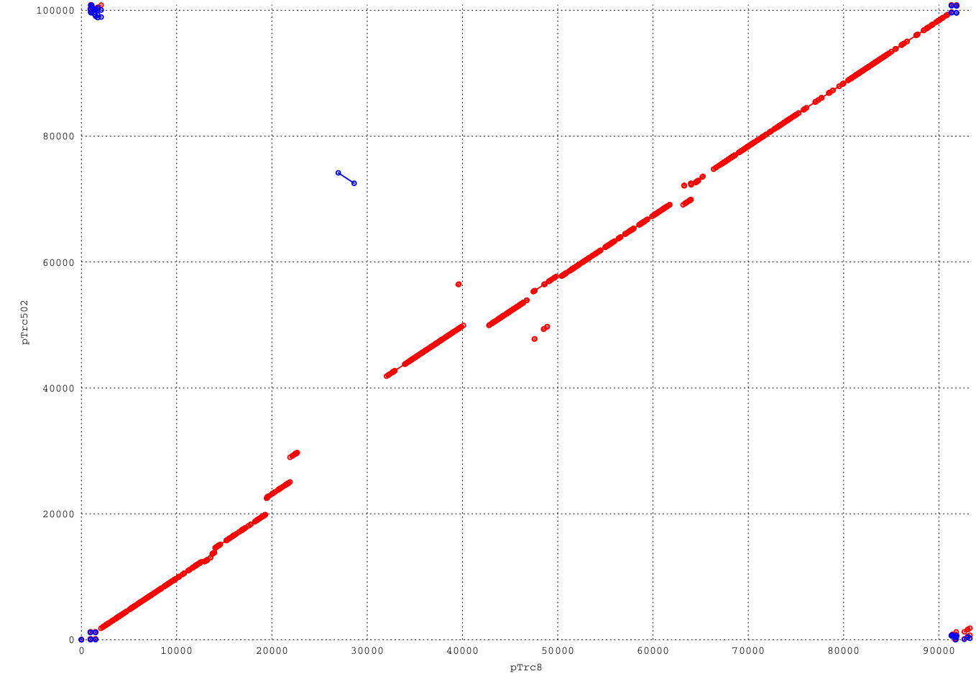
For the selection of ranges in the plasmid genomes that support unique identification, whole genome alignment was performed using MUMer (version 3.23), leading to the following dot-plot:
A high overall homology matching segments in the same orientation (indicated by red dots) as well as a small inversion (indicated by blue dots) is evident. The only larger region without any homology is in the segment 29330-42050 on pTrc502 and 23000-26950 on pTrc8.

Slide 3
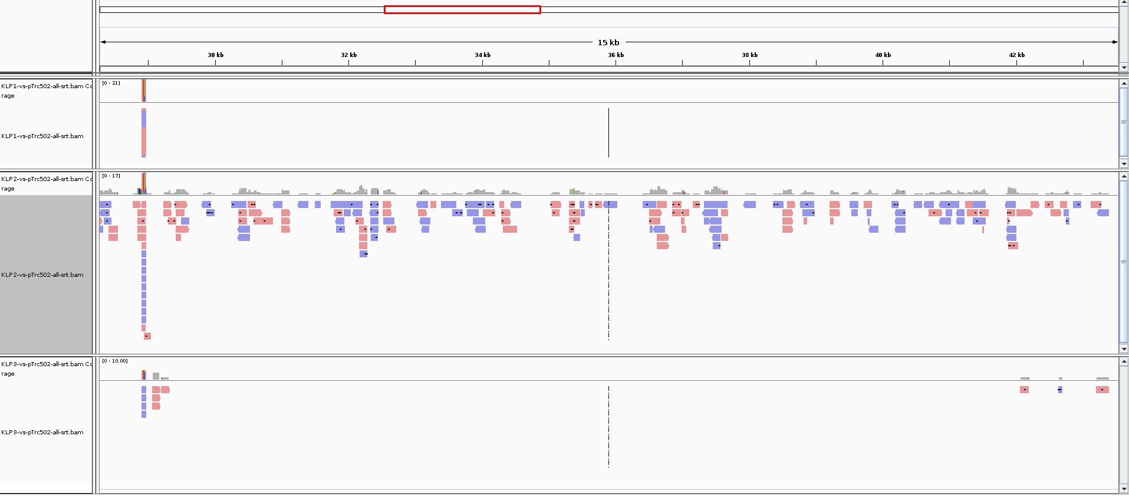
Visualizing the NGS reads in these segments
Reads in KLPNC1-ecoli-res (top), KLPNC2-Trs502 (middle) and KLPNC3-Trs8 (bottom) aligned around the segment 29330-42050 of pTrc502:

Slide 4
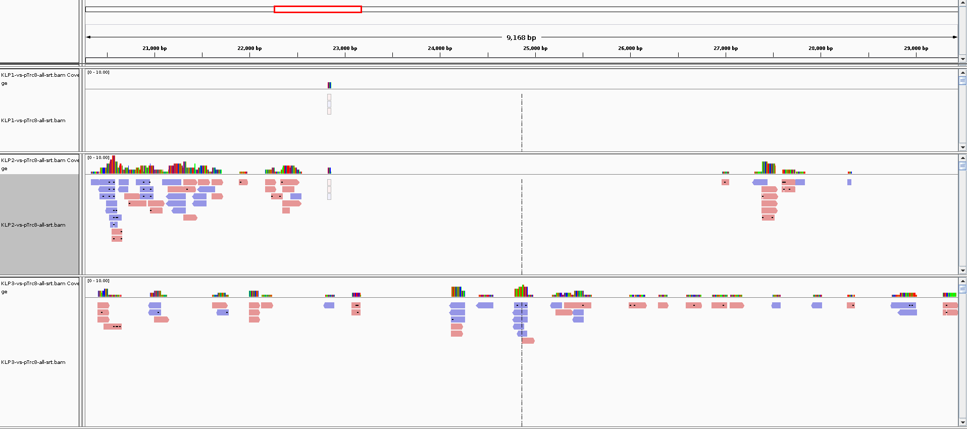
Visualizing the NGS reads in these segments
Reads in KLPNC1-ecoli-res (top), KLPNC2-Trs502 (middle) and KLPNC3-Trs8 (bottom) aligned around the segment 23000-26950 of pTrc8:

Slide 5
The number of reads aligning in these regions are:
For these 3 samples, a perfect separation (without any false positives or false negatives) of their plasmid content is possible.

Slide 6
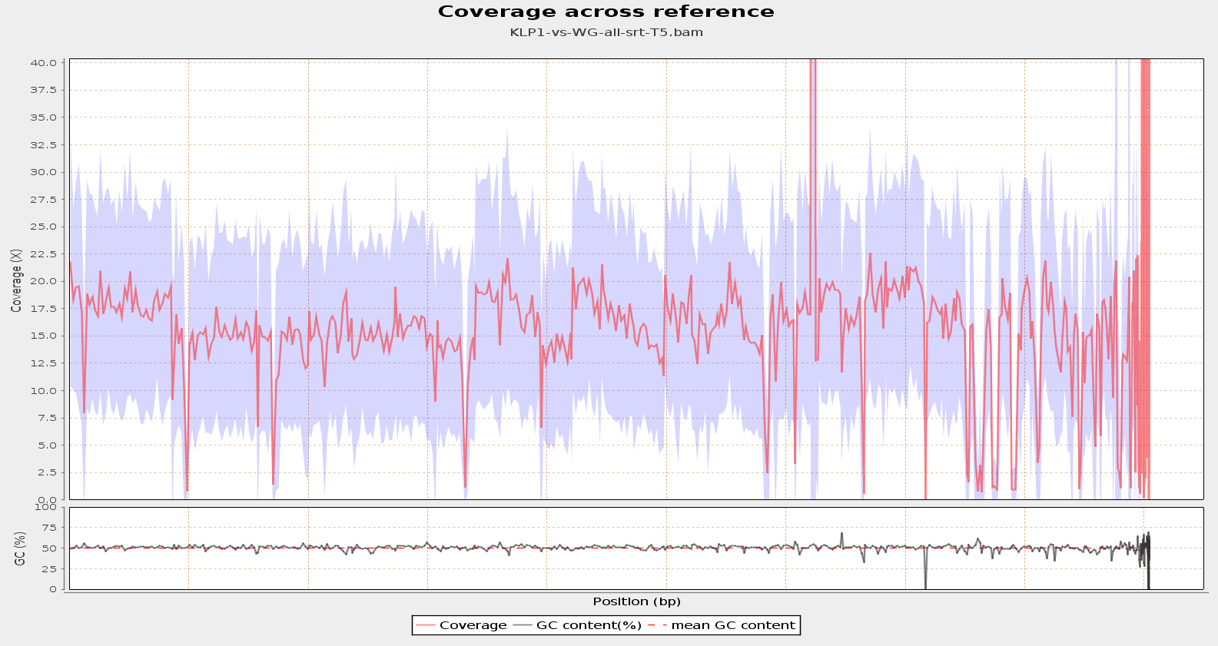

Slide 7
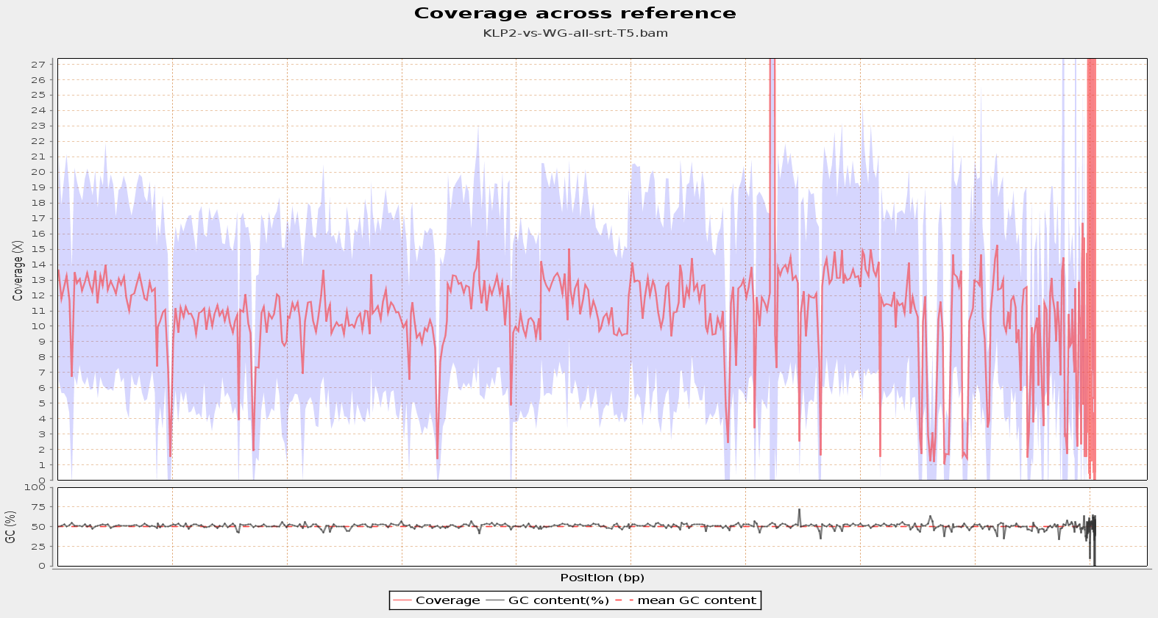

Slide 8
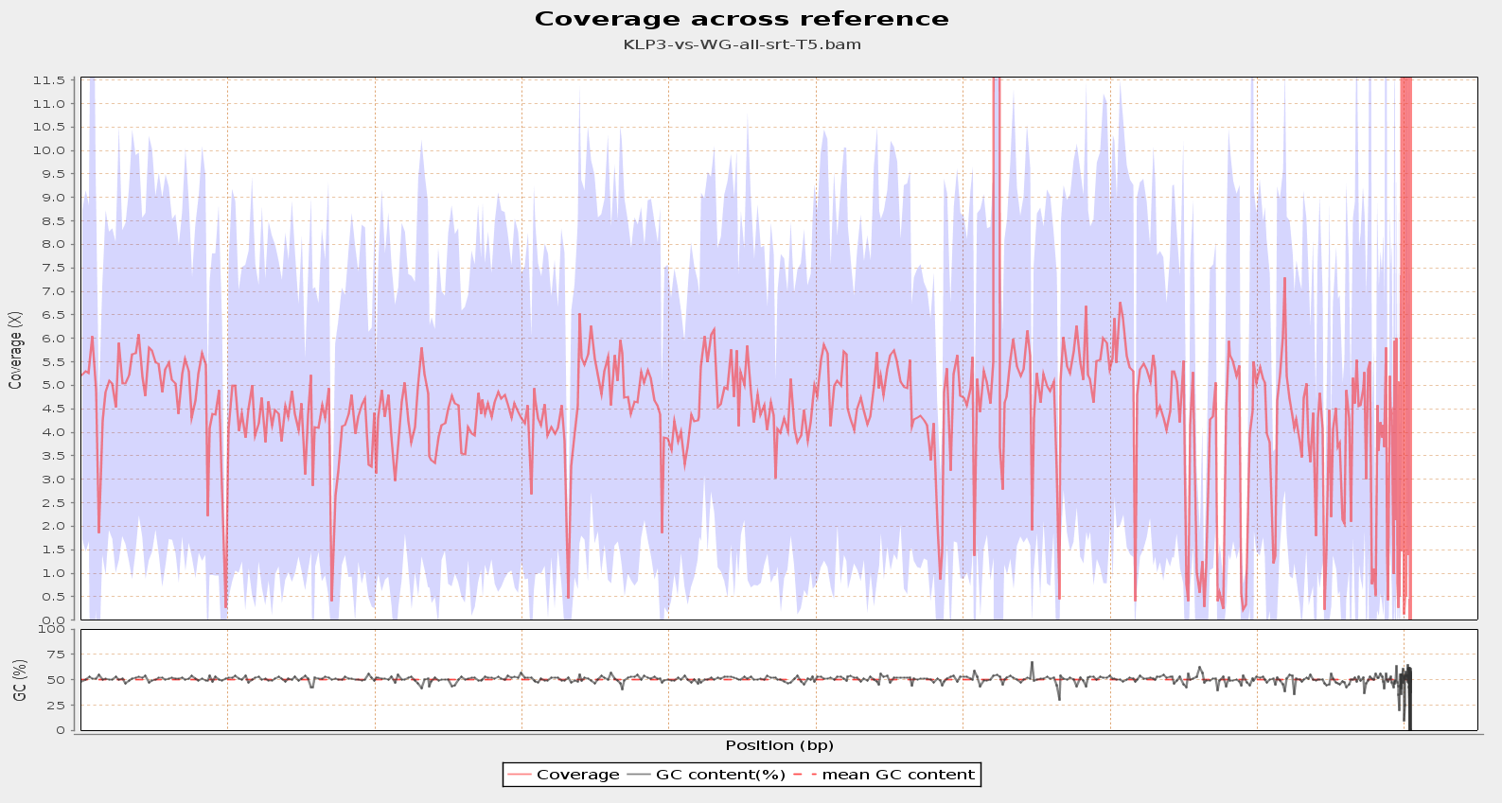

Slide 9
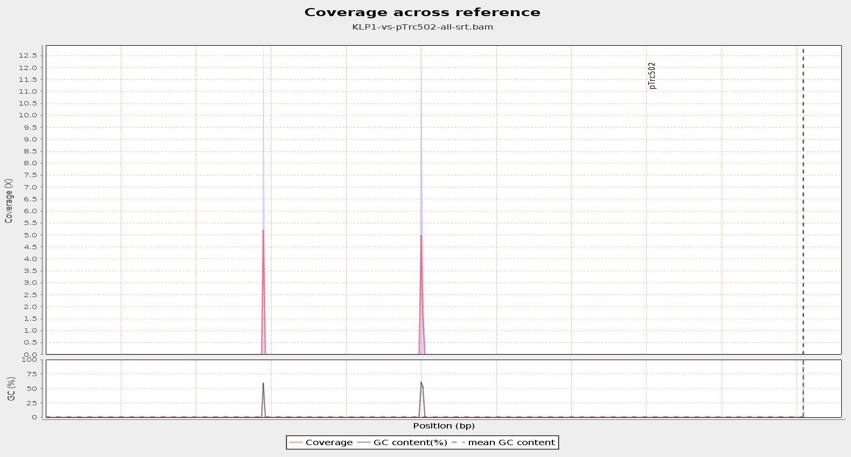

Slide 10
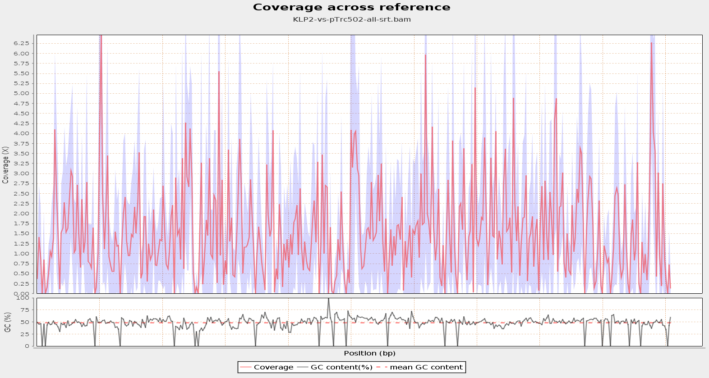

Slide 11
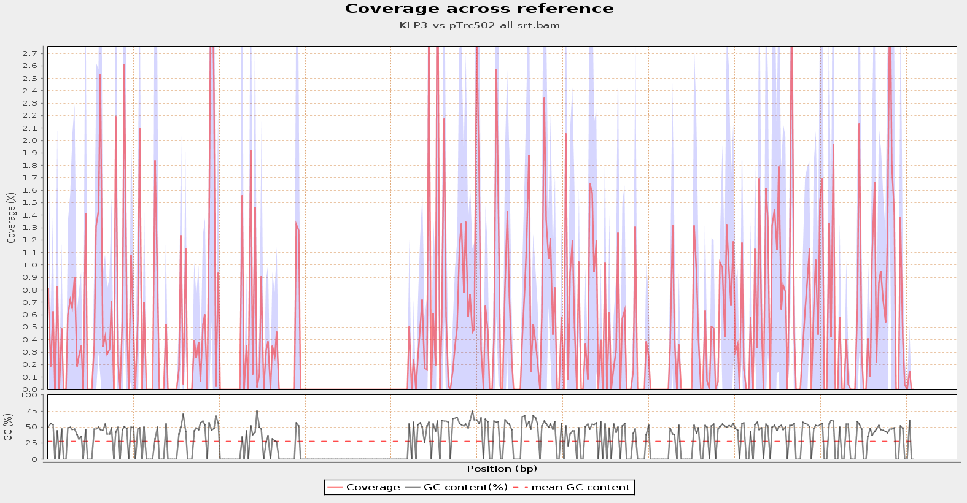

Slide 12
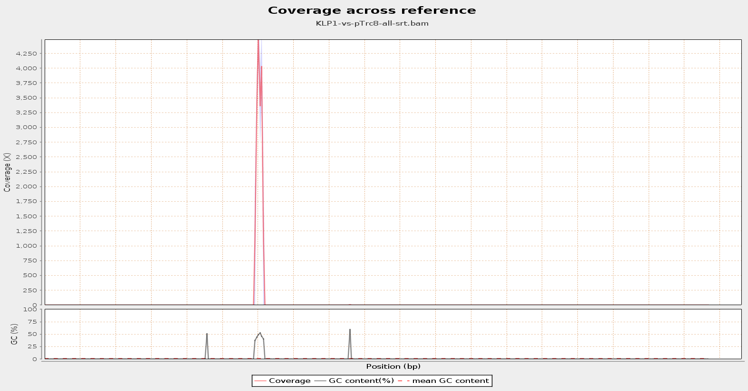

Slide 13
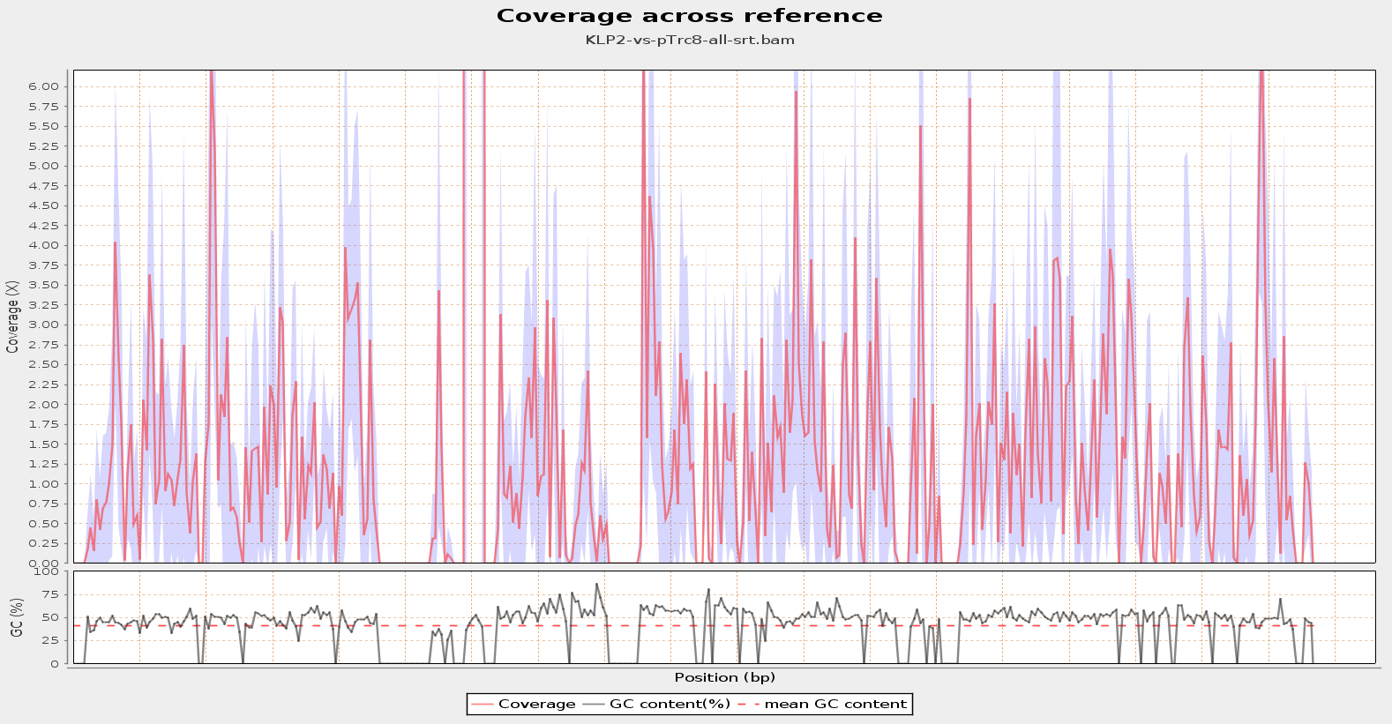

Slide 14
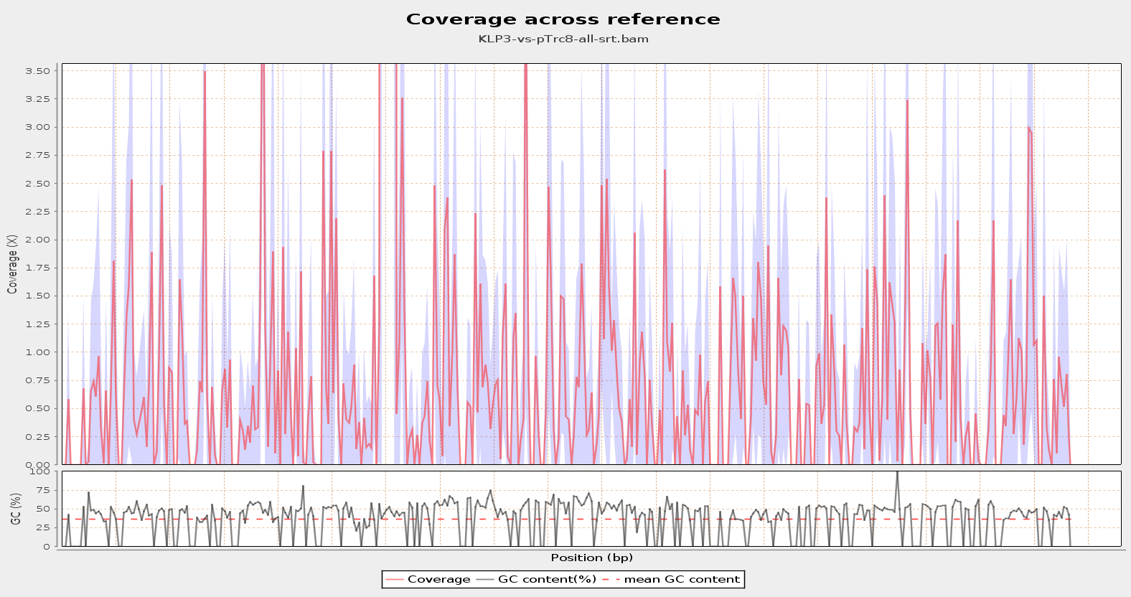

Slide 15
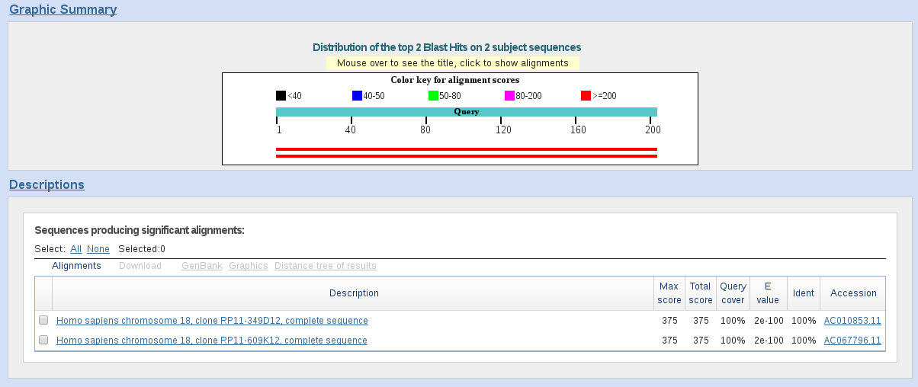
unmapped reads assignment: human

Slide 16
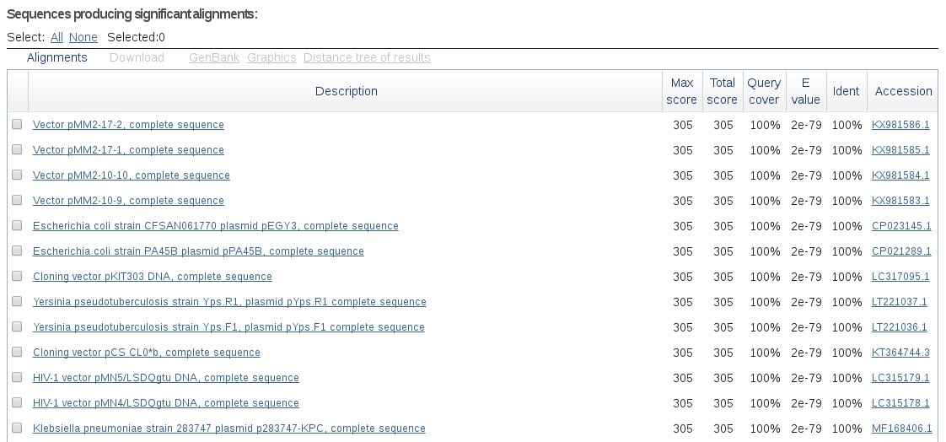
unmapped reads assignment: vectors+plasmids

Slide 17
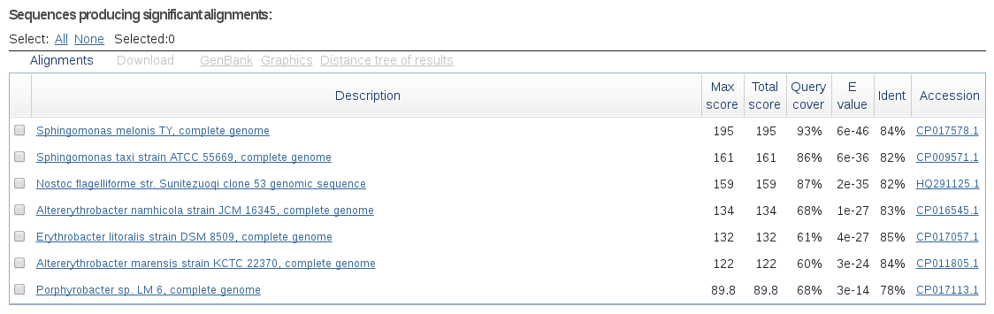
unmapped reads assignment: bacterial

Slide 18
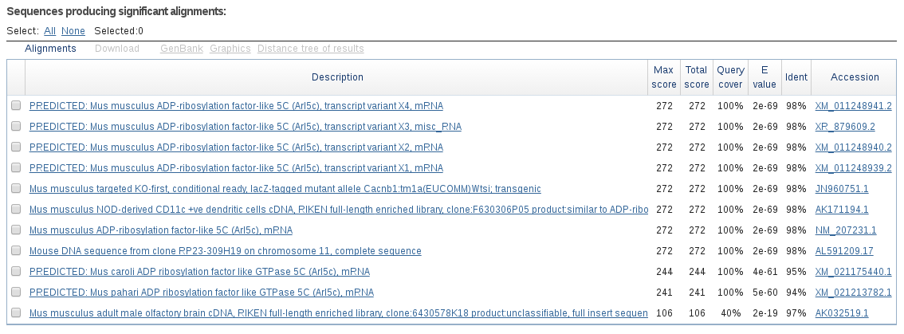
unmapped reads assignment: mouse

Slide 19
KLPNC1-ecoli-res reads assignment

Slide 20
Mapping statistics
#1_wg
Reference size
4,522,677
Number of reads
581,617
Mapped reads
581,617 / 100%
Supplementary alignments
2,554 / 0.44%
Unmapped reads
0 / 0%
Mapped paired reads
0 / 0%
Read min/max/mean length
19 / 372 / 133.11
Duplicated reads (estimated)
355,875 / 61.19%
Duplication rate
57.59%
Clipped reads
51,636 / 8.88%
ACGT Content
Number/percentage of A's
18,286,087 / 24.37%
Number/percentage of C's
19,021,578 / 25.36%
Number/percentage of T's
18,413,410 / 24.54%
Number/percentage of G's
19,298,838 / 25.72%
Number/percentage of N's
0 / 0%
GC Percentage
51.08%
Coverage
Mean
16.6401
Standard Deviation
55.3412
Mapping Quality
Mean Mapping Quality
54.45
Mismatches and indels
General error rate
1.24%
Mismatches
828,336
Insertions
97,631
Mapped reads with at least one insertion
10.83%
Deletions
222,530
Mapped reads with at least one deletion
27.79%
Homopolymer indels
68.11%

Slide 21
Mapping statistics
#2_wg
Reference size
4,522,677
Number of reads
404,965
Mapped reads
404,965 / 100%
Supplementary alignments
1,804 / 0.45%
Unmapped reads
0 / 0%
Mapped paired reads
0 / 0%
Read min/max/mean length
19 / 374 / 134.25
Duplicated reads (estimated)
139,643 / 34.48%
Duplication rate
28.34%
Clipped reads
43,469 / 10.73%
ACGT Content
Number/percentage of A's
12,751,655 / 24.3%
Number/percentage of C's
13,362,046 / 25.47%
Number/percentage of T's
12,820,622 / 24.44%
Number/percentage of G's
13,531,512 / 25.79%
Number/percentage of N's
0 / 0%
GC Percentage
51.26%
Coverage
Mean
11.6365
Standard Deviation
38.5685
Mapping Quality
Mean Mapping Quality
54.86
Mismatches and indels
General error rate
1.4%
Mismatches
558,163
Insertions
164,846
Mapped reads with at least one insertion
23.74%
Deletions
153,406
Mapped reads with at least one deletion
28.08%
Homopolymer indels
51.73%

Slide 22
Mapping statistics
#3_wg
Reference size
4,522,677
Number of reads
169,124
Mapped reads
169,124 / 100%
Supplementary alignments
943 / 0.56%
Unmapped reads
0 / 0%
Mapped paired reads
0 / 0%
Read min/max/mean length
19 / 339 / 136.29
Duplicated reads (estimated)
54,268 / 32.09%
Duplication rate
26.43%
Clipped reads
21,345 / 12.62%
ACGT Content
Number/percentage of A's
5,289,907 / 24.47%
Number/percentage of C's
5,458,876 / 25.25%
Number/percentage of T's
5,322,358 / 24.62%
Number/percentage of G's
5,549,479 / 25.67%
Number/percentage of N's
0 / 0%
GC Percentage
50.92%
Coverage
Mean
4.7953
Standard Deviation
15.7088
Mapping Quality
Mean Mapping Quality
54.11
Mismatches and indels
General error rate
1.23%
Mismatches
235,120
Insertions
28,610
Mapped reads with at least one insertion
10.89%
Deletions
62,627
Mapped reads with at least one deletion
26.65%
Homopolymer indels
67.77%

Slide 23
Mapping statistics
#1_502
Reference size
100,886
Number of reads
40
Mapped reads
40 / 100%
Unmapped reads
0 / 0%
Mapped paired reads
0 / 0%
Read min/max/mean length
104 / 254 / 155.15
Duplicated reads (estimated)
35 / 87.5%
Duplication rate
40%
Clipped reads
40 / 100%
ACGT Content
Number/percentage of A's
763 / 25.62%
Number/percentage of C's
702 / 23.57%
Number/percentage of T's
463 / 15.55%
Number/percentage of G's
1,050 / 35.26%
Number/percentage of N's
0 / 0%
GC Percentage
58.83%
Coverage
Mean
0.0295
Standard Deviation
0.72
Mapping Quality
Mean Mapping Quality
0.25
Mismatches and indels
General error rate
10.17%
Mismatches
285
Insertions
18
Mapped reads with at least one insertion
45%
Deletions
1
Mapped reads with at least one deletion
2.5%
Homopolymer indels
100%
#2_502
Reference size
100,886
Number of reads
1,149
Mapped reads
1,149 / 100%
Supplementary alignments
1 / 0.09%
Unmapped reads
0 / 0%
Mapped paired reads
0 / 0%
Read min/max/mean length
31 / 308 / 139.93
Duplicated reads (estimated)
272 / 23.67%
Duplication rate
21.21%
Clipped reads
113 / 9.83%
ACGT Content
Number/percentage of A's
37,952 / 24.14%
Number/percentage of C's
38,264 / 24.33%
Number/percentage of T's
40,634 / 25.84%
Number/percentage of G's
40,398 / 25.69%
Number/percentage of N's
0 / 0%
GC Percentage
50.02%
Coverage
Mean
1.5653
Standard Deviation
1.7065
Mapping Quality
Mean Mapping Quality
55.03
Mismatches and indels
General error rate
1.19%
Mismatches
1,156
Insertions
687
Mapped reads with at least one insertion
34.46%
Deletions
640
Mapped reads with at least one deletion
35.42%
Homopolymer indels
52.15%
#3_502
Reference size
100,886
Number of reads
366
Mapped reads
366 / 100%
Supplementary alignments
2 / 0.55%
Unmapped reads
0 / 0%
Mapped paired reads
0 / 0%
Read min/max/mean length
38 / 290 / 141.24
Duplicated reads (estimated)
95 / 25.96%
Duplication rate
23.62%
Clipped reads
77 / 21.04%
ACGT Content
Number/percentage of A's
11,356 / 23.72%
Number/percentage of C's
11,897 / 24.85%
Number/percentage of T's
12,070 / 25.21%
Number/percentage of G's
12,557 / 26.23%
Number/percentage of N's
0 / 0%
GC Percentage
51.07%
Coverage
Mean
0.4767
Standard Deviation
0.9636
Mapping Quality
Mean Mapping Quality
31.28
Mismatches and indels
General error rate
3.14%
Mismatches
1,423
Insertions
71
Mapped reads with at least one insertion
13.66%
Deletions
192
Mapped reads with at least one deletion
35.79%
Homopolymer indels
65.78%
#1_8
Reference size
93,387
Number of reads
32,216
Mapped reads
32,216 / 100%
Supplementary alignments
4 / 0.01%
Unmapped reads
0 / 0%
Mapped paired reads
0 / 0%
Read min/max/mean length
30 / 310 / 133.42
Duplicated reads (estimated)
31,113 / 96.58%
Duplication rate
98.37%
Clipped reads
4,592 / 14.25%
ACGT Content
Number/percentage of A's
1,119,770 / 27.39%
Number/percentage of C's
925,759 / 22.64%
Number/percentage of T's
1,059,013 / 25.9%
Number/percentage of G's
983,958 / 24.07%
Number/percentage of N's
0 / 0%
GC Percentage
46.71%
Coverage
Mean
43.9549
Standard Deviation
404.595
Mapping Quality
Mean Mapping Quality
0.98
Mismatches and indels
General error rate
1.17%
Mismatches
41,994
Insertions
5,467
Mapped reads with at least one insertion
10.6%
Deletions
15,647
Mapped reads with at least one deletion
33.21%
Homopolymer indels
77.66%
#2_8
Reference size
93,387
Number of reads
18,677
Mapped reads
18,677 / 100%
Supplementary alignments
5 / 0.03%
Unmapped reads
0 / 0%
Mapped paired reads
0 / 0%
Read min/max/mean length
30 / 308 / 134.15
Duplicated reads (estimated)
16,937 / 90.68%
Duplication rate
69.31%
Clipped reads
2,720 / 14.56%
ACGT Content
Number/percentage of A's
647,687 / 27.09%
Number/percentage of C's
548,771 / 22.95%
Number/percentage of T's
607,434 / 25.41%
Number/percentage of G's
586,948 / 24.55%
Number/percentage of N's
0 / 0%
GC Percentage
47.5%
Coverage
Mean
25.6897
Standard Deviation
229.0585
Mapping Quality
Mean Mapping Quality
45.89
Mismatches and indels
General error rate
1.43%
Mismatches
25,132
Insertions
8,483
Mapped reads with at least one insertion
26.2%
Deletions
7,935
Mapped reads with at least one deletion
29.91%
Homopolymer indels
55.1%
#3_8
Reference size
93,387
Number of reads
9,177
Mapped reads
9,177 / 100%
Supplementary alignments
1 / 0.01%
Unmapped reads
0 / 0%
Mapped paired reads
0 / 0%
Read min/max/mean length
32 / 316 / 136.39
Duplicated reads (estimated)
7,795 / 84.94%
Duplication rate
73.15%
Clipped reads
1,325 / 14.44%
ACGT Content
Number/percentage of A's
324,031 / 27.24%
Number/percentage of C's
270,604 / 22.75%
Number/percentage of T's
309,064 / 25.98%
Number/percentage of G's
285,848 / 24.03%
Number/percentage of N's
0 / 0%
GC Percentage
46.78%
Coverage
Mean
12.7874
Standard Deviation
111.7557
Mapping Quality
Mean Mapping Quality
43.11
Mismatches and indels
General error rate
1.13%
Mismatches
11,814
Insertions
1,588
Mapped reads with at least one insertion
11.31%
Deletions
4,434
Mapped reads with at least one deletion
32.96%
Homopolymer indels
77.27%

