Slide 1
Pilot study: Detection of bacterial plasmids using NGS Bioinformatics analysis by M. Reczko, BSRC A. Fleming
The following samples were sequenced using the Ion Proton:
KLPNC1-ecoli-res (1453369 reads, Mean Read Length: 130 bp)
KLPNC2-Trs502 (1091825 reads, Mean Read Length: 131 bp)
KLPNC3-Trs8 (1434440 reads, Mean Read Length: 133 bp)
All reads were aligned to the provided reference assemblies:
WG5 - the recipient E.coli (4522677 bp)
Trs502 (100886 bp)
Trs8 (93387 bp)
using bwa (version 0.7.16a) with default parameters.

Slide 2
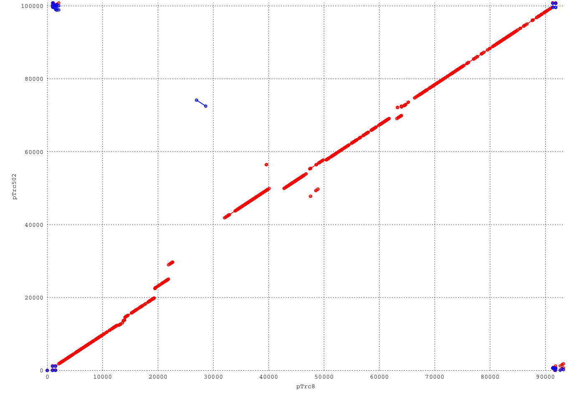
For the selection of ranges in the plasmid genomes that support unique identification, whole genome alignment was performed using MUMer (version 3.23), leading to the following dot-plot:
A high overall homology matching segments in the same orientation (indicated by red dots) as well as a small inversion (indicated by blue dots) is evident. The only larger region without any homology is in the segment 29330-42050 on pTrc502 and 23000-26950 on pTrc8.

Slide 3
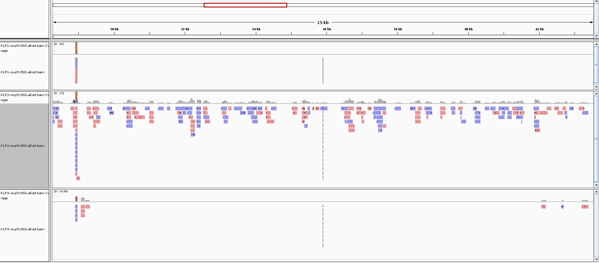
Visualizing the NGS reads in these segments
Reads in KLPNC1-ecoli-res (top), KLPNC2-Trs502 (middle) and KLPNC3-Trs8 (bottom) aligned around the segment 29330-42050 of pTrc502:

Slide 4
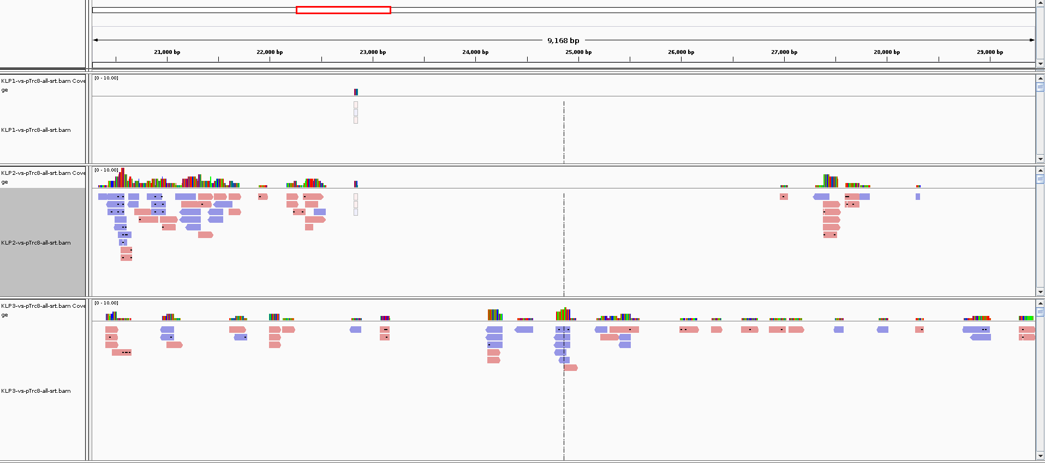
Visualizing the NGS reads in these segments
Reads in KLPNC1-ecoli-res (top), KLPNC2-Trs502 (middle) and KLPNC3-Trs8 (bottom) aligned around the segment 23000-26950 of pTrc8:

Slide 5
The number of reads aligning in these regions are:
For these 3 samples, a perfect separation (without any false positives or false negatives) of their plasmid content is possible.

Slide 6
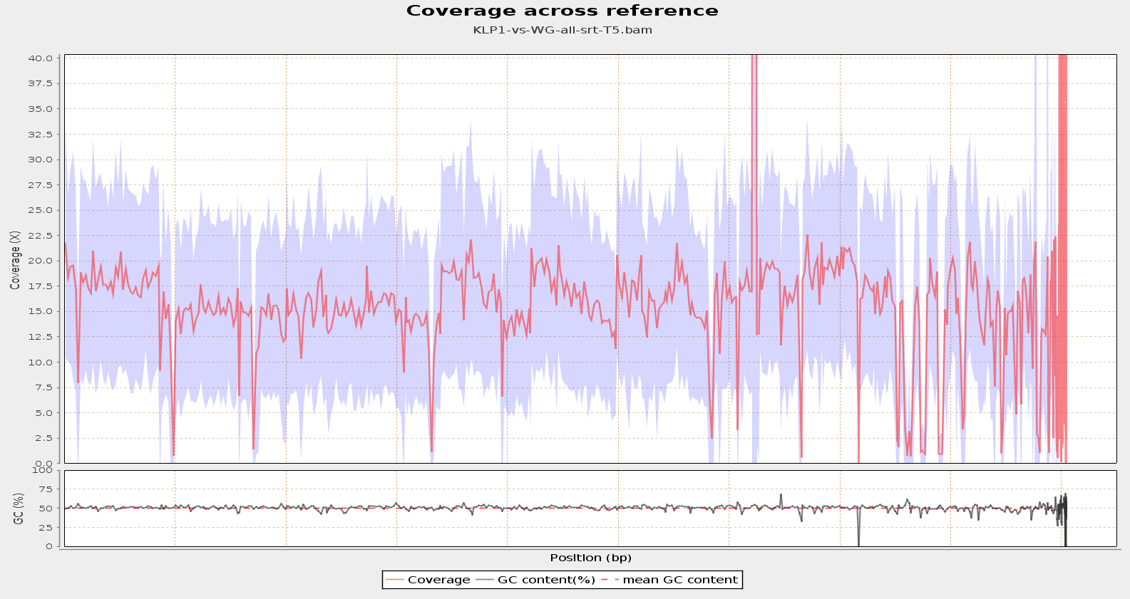

Slide 7
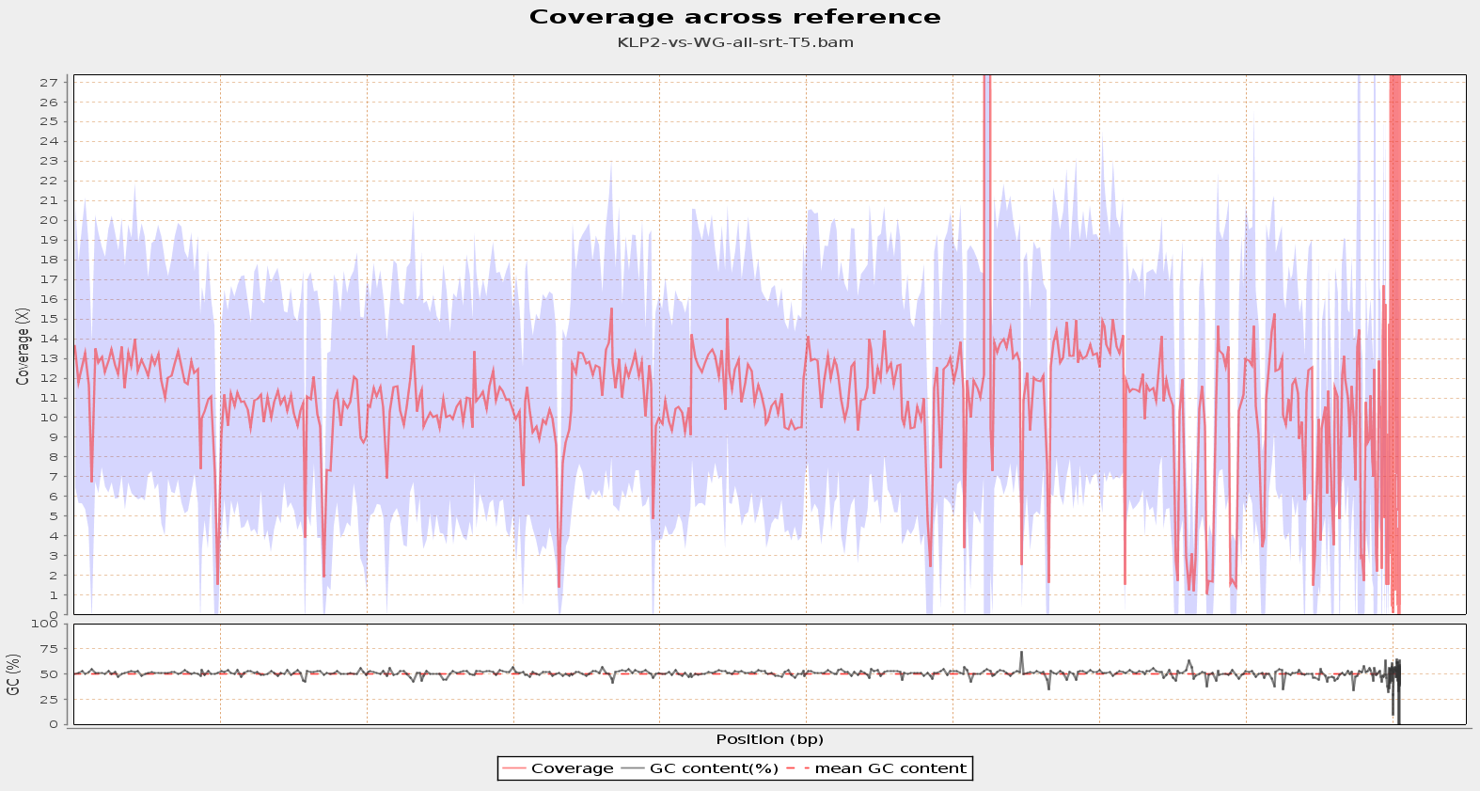

Slide 8
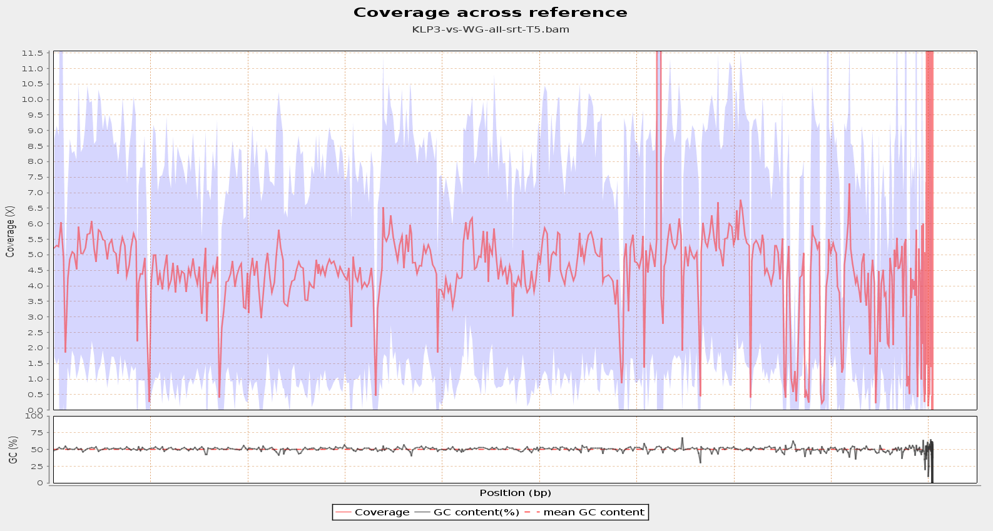

Slide 9
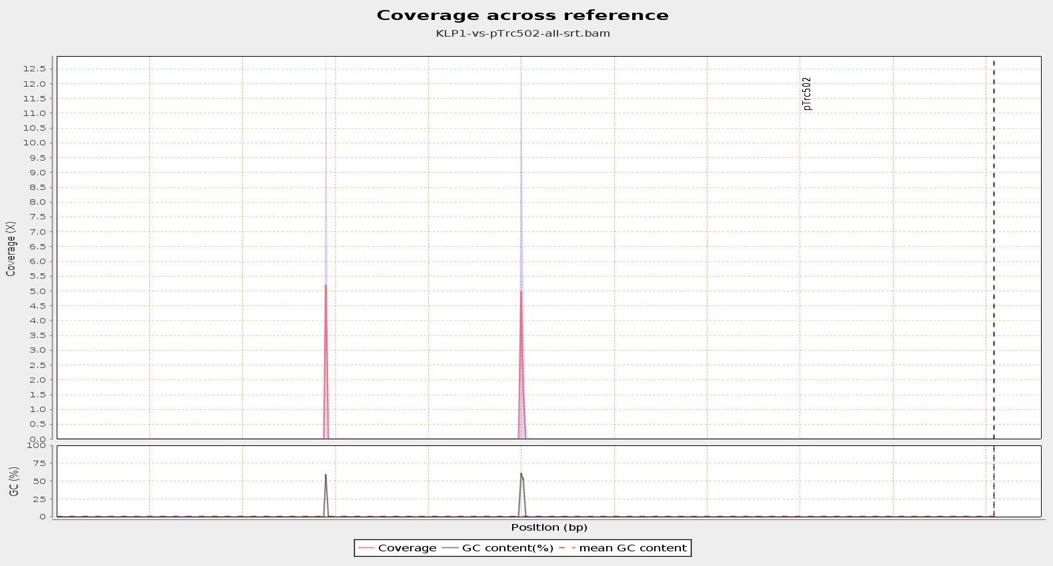

Slide 10
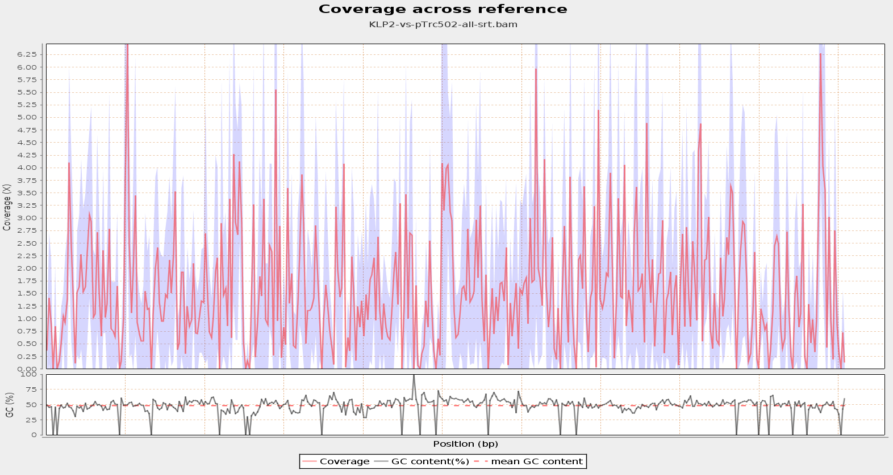

Slide 11
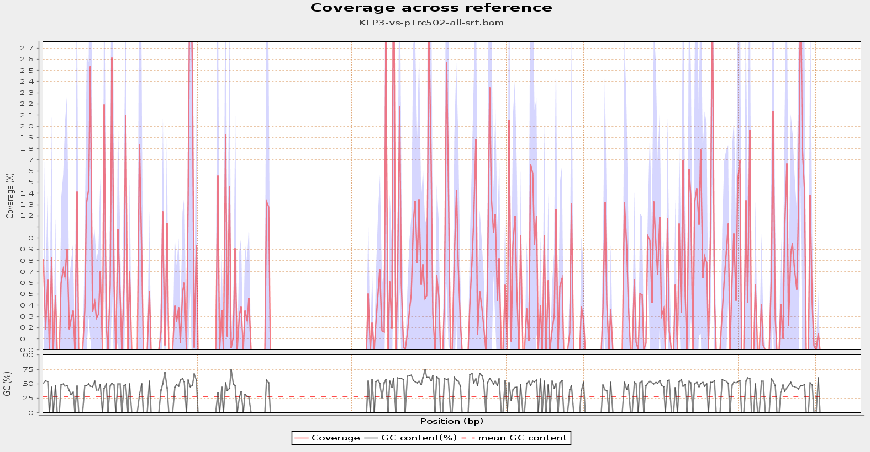

Slide 12
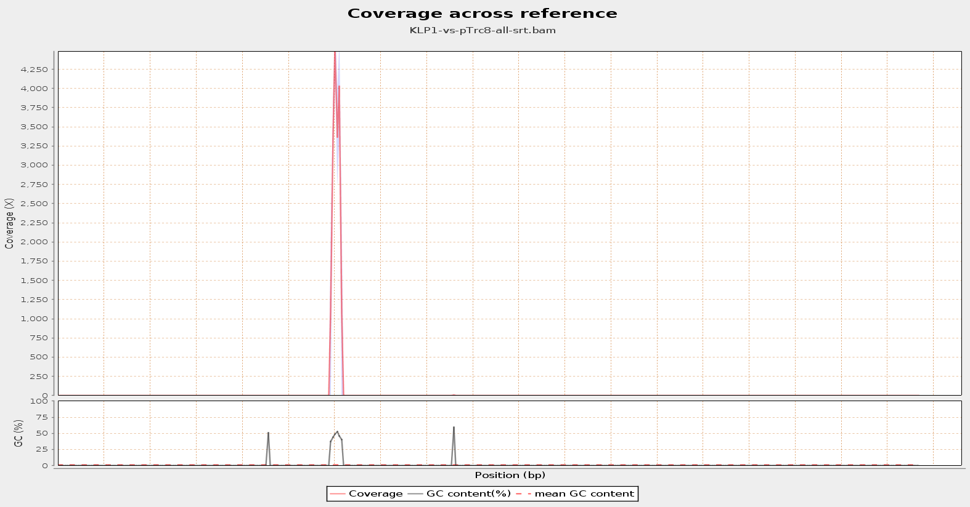

Slide 13
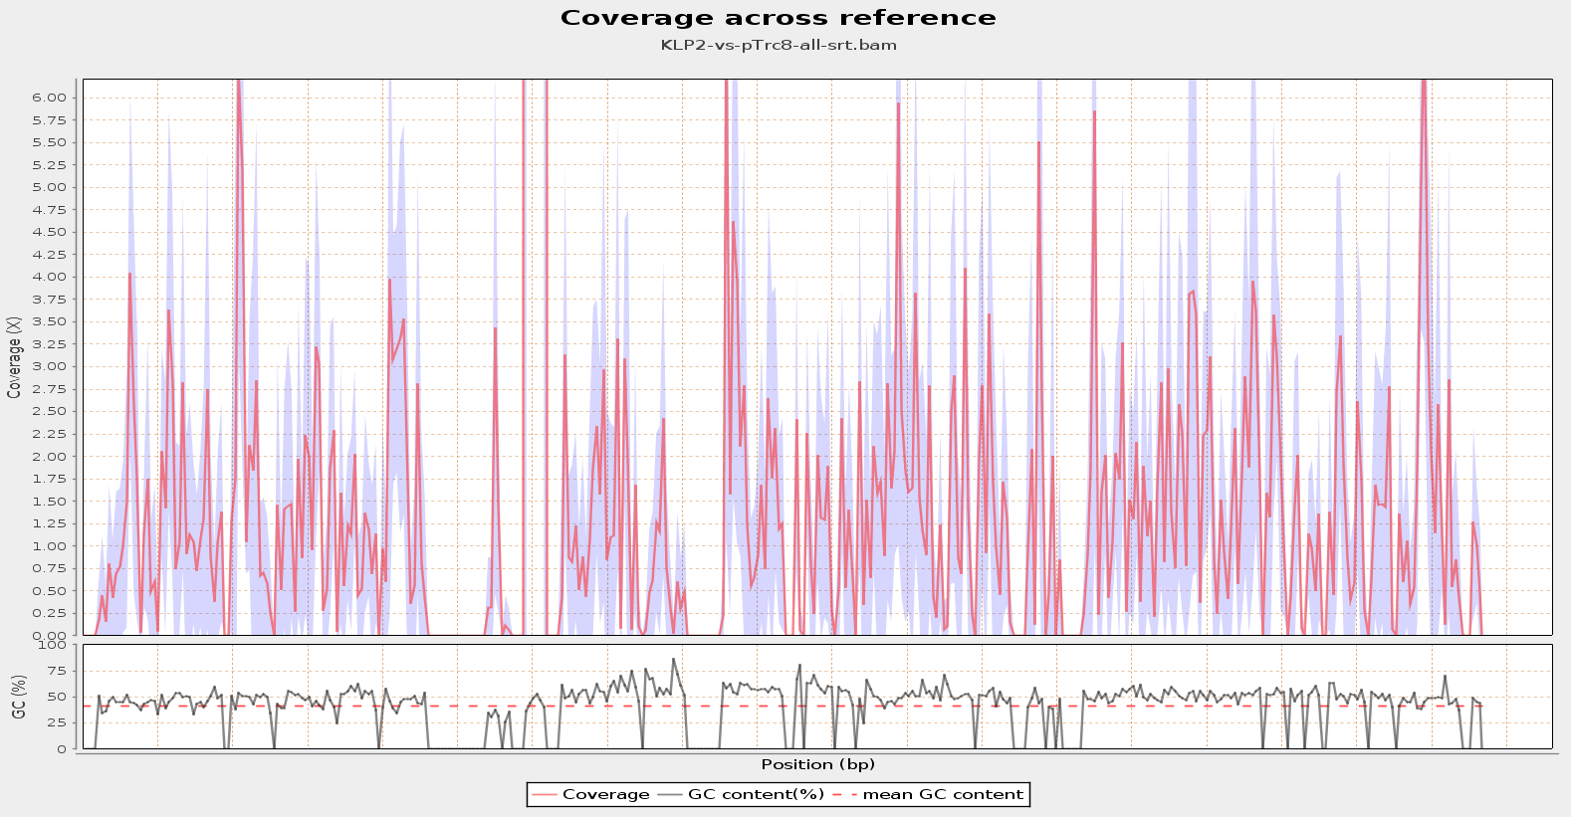

Slide 14
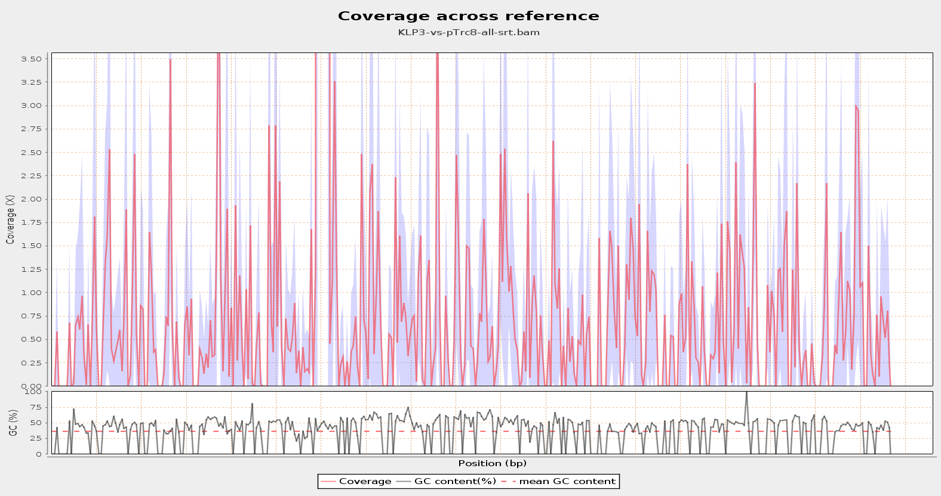

Slide 15
KLPNC1-ecoli-res reads assignment

